Slide 1







Insight Resource
Group Inc
National Staffing Solutions, executive search, technology recruitment agency
Meet the team :
Mahnoor Khan
Shreya Shreya
Edward Chiang
Pedro Gamundi
Fengrong Xing
Christabella Batara

Slide 2
Overview of the Company & Sector
Founded in 2013, a company of 10 employees, headquartered in New York
Executive search services to Fortune 500 firms in skill areas: Executive Management, Information Technology, Business Operations, Sales, and ITO/BPO.
Provides a forum to match candidates with opportunity and career growth.
Services :
Employers - Curated network of highly qualified candidates
Job seekers - Guidance and Coaching through the process

Slide 3
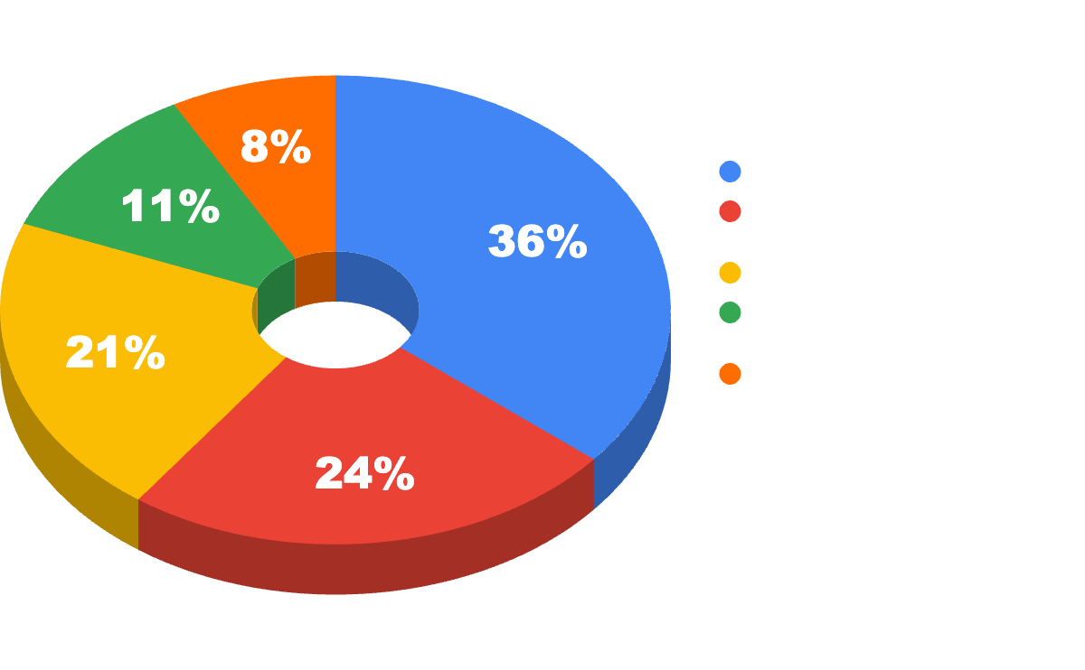
Overview of the Company & Sector
Provided job and career opportunities for about 16 million employees per year pre-pandemic (13.6 million during the pandemic).
Wide range of employment-related services,
28% growth y/y 2021
218 billion revenue in 2022
More than the combined staffing revenue size of the UK, Germany, France, Australia, Spain, India, Sweden, Turkey, and Saudi Arabia

Slide 4
Overview of the Stakeholder
Jennifer Widerberg
B.S. in Psychology, Boston University
2006 - 2013: Account Manager/IT Recruiter at M-Logic Inc.
2013 - Present: Managing Director at Insight Resource Group Inc.
Financial services tech recruiter
Business development, account management, recruiting, marketing, writing content, social media, etc.

Slide 5
IT Challenges and Solutions
Main Challenge → More accessible service without having to perform each task manually
Answering similar questions in each meeting
Broken links and difficulty in navigating the website
Solution → Integration of chatbot into Insight’s website
Respond to basic prompts
Receive resumes and set up meetings
Subscription Based
Pros:
Lower-Cost and scalability
Easy implementation
Regular maintenance and security updates

Slide 6
Dante AI
Dante AI is a sophisticated AI personal assistant and chatbot platform.
Provides a no-code solution, making it accessible for users without technical expertise.
Aims to boost productivity and streamline information processing.
Offers customizable AI solutions tailored to individual business needs that offers data security and sentiment analysis.
Known for superior customization and high-quality response generation.
Enables creation of tailored chatbots trained on specific datasets.

Slide 7
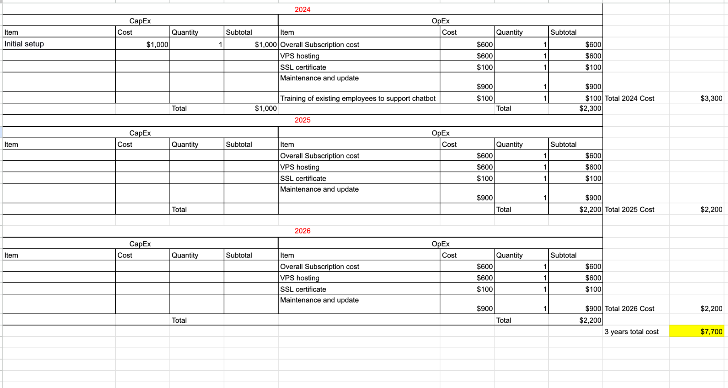
3-year overview of the financials of Dante AI (CapEx & OpEx)

Slide 8
II. ChatGPT
Large language model-based chatbot allowing refined conversation control in terms of length, format, style, and detail.
Offers flexibility in conversation style, detail, and format.
Built on GPT-3.5 or GPT-4, using transformer architecture and fine-tuned for chat applications.
Employed supervised and reinforcement learning techniques for development.
Gained 100 million users by January 2023, significantly increasing OpenAI's valuation.

Slide 9
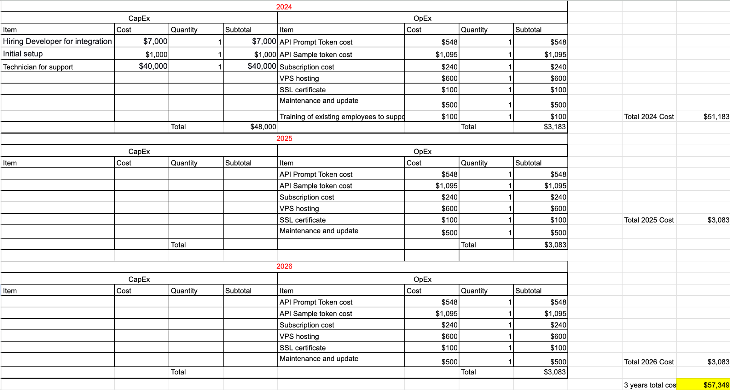
3-year overview of the financials of ChatGPT (CapEx & OpEx)

Slide 10
III. Chatsimple
An innovative AI virtual agent with a quick 5-minute setup.
Utilizes website data for effortless integration, no coding required.
Supports over 175 languages, enabling global customer connectivity.
Provides 24/7 service, effectively converting visitors to customers.
Offers a range of plans from a free trial to elite options, catering to various budgets.
Featured in Yahoo Finance and recognized on Product Hunt, marking its industry leadership.

Slide 11
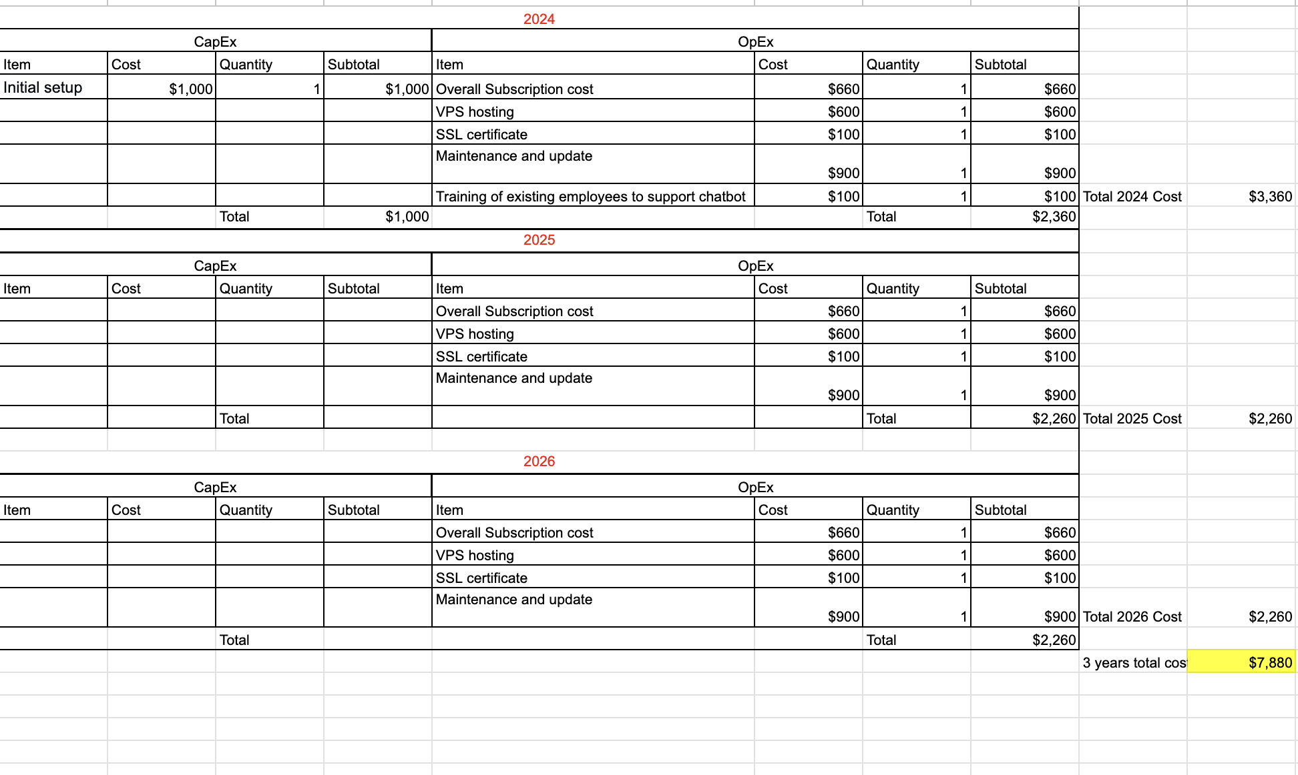
3-year overview of the financials of ChatSimple (CapEx & OpEx)

Slide 12
Top 8 Considerations
FEATURES | WEIGHT
Chatbot Interaction Quality and User Engagement | 10
Compliance and Data Security | 10
Ease of Integration with Website Platforms | 9
Cost-Effectiveness | 9
SEO and Traffic Generation Capabilities | 8
Data Collection and Analytics | 8
Technical Support and Maintenance | 7
Scalability and Performance Under Load | 7

Slide 13
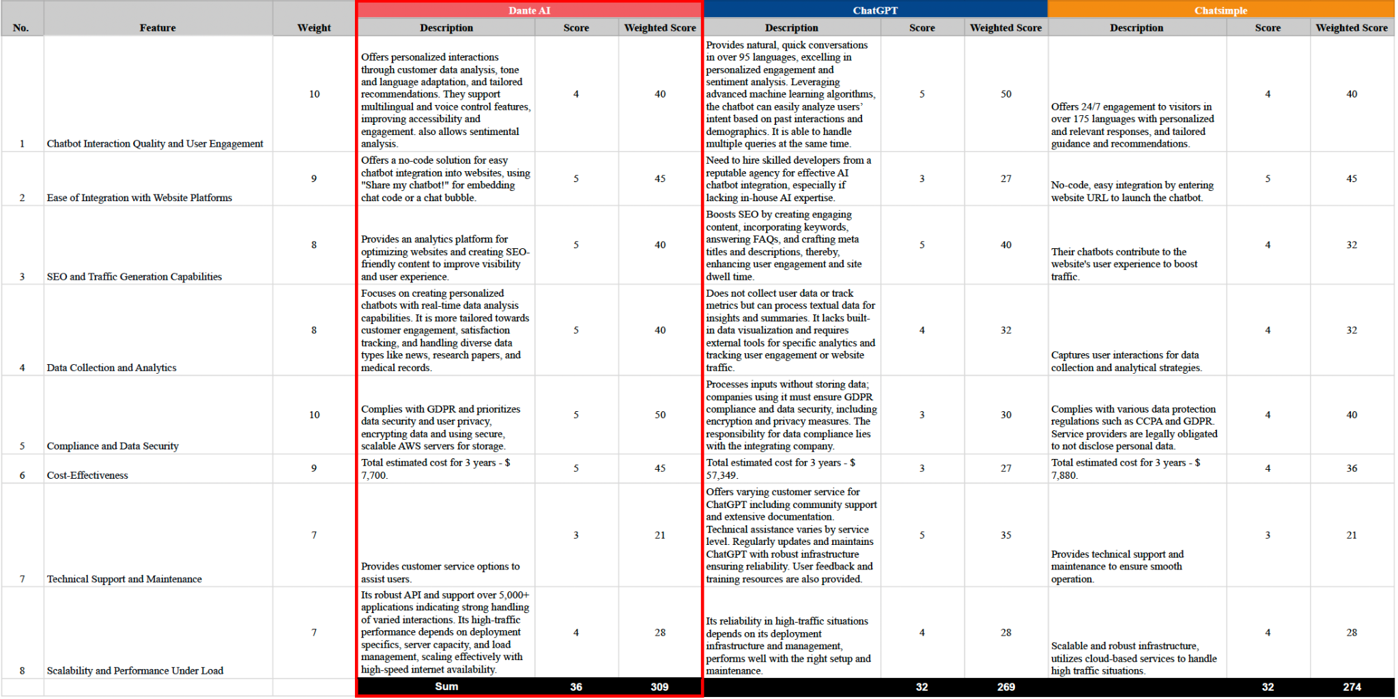
Comparison Matrix

Slide 14

Proposal Recommendation
Recommended AI Chatbot: Dante AI
Dante AI emerges with the highest weighted score based on the comparison matrix
Dante AI scored the highest on features with the highest weighting:
Compliance and Data Security
Cost-effectiveness
Data Collection and Analytics
With Dante AI, Insights Resources Group Inc, can innovate operational processes, optimize manual tasks, and pioneer staffing industry technological advancements.

Slide 15

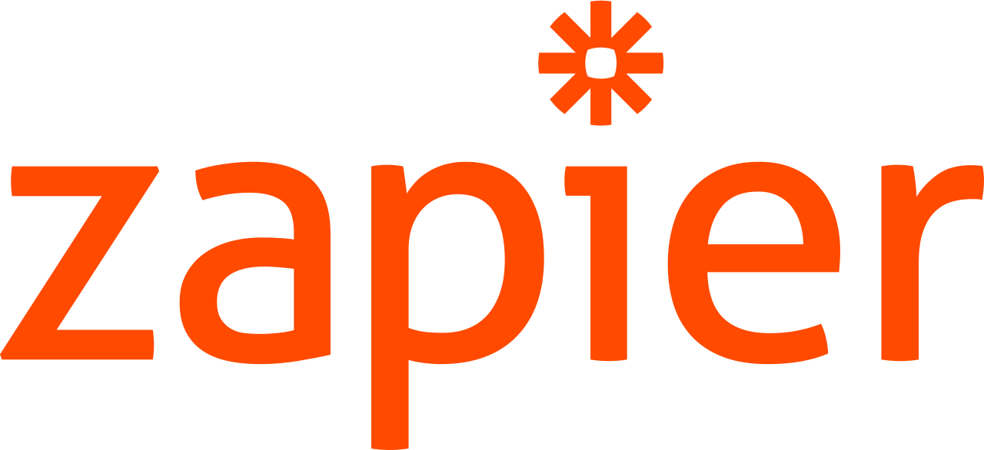
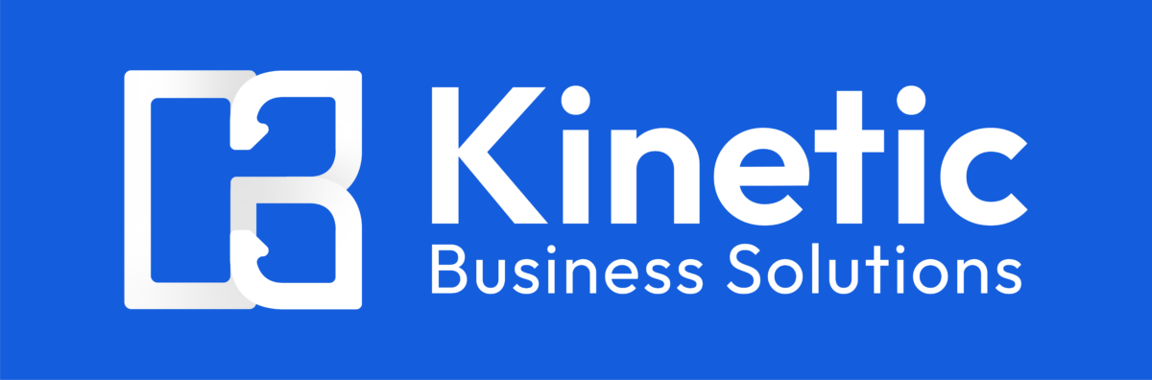

Companies with Dante AI Chatbot Integration
Slack integrated Dante AI to facilitate message replies on Slack.
Zapier integrated Dante AI chatbot to be made available on applications that are connected to Zapier.
Kinetic Business Solutions and Origin Travel Nurse both has chatbots on their website that are powered by Dante AI

Slide 16
Project Plan
Planning
1/1/24 - 2/1/24
Analysis
2/2/24 - 3/12/24
Design
3/13/24 - 5/14/24
Define project timeline
Identify Resources
Check feasibility
Gather detailed requirements
Analyze capabilities
Define user personas
Create system architecture
Design user interface
Design data models

Slide 17
Project Plan
Development
5/15/24 - 9/17/24
Testing
9/18/24 - 11/12/24
Implementation
11/13/24 - 12/24/24
Maintenance
12/25/24 -
Set up environment
Code integration API
Develop and Test individual module
Unit testing
Perform system /integration testing
User acceptance testing
Implement a phased rollout
Monitor system performance
Provide training and support
Regularly update the system
Monitor user feedback
Continuous performance evaluation

Slide 18
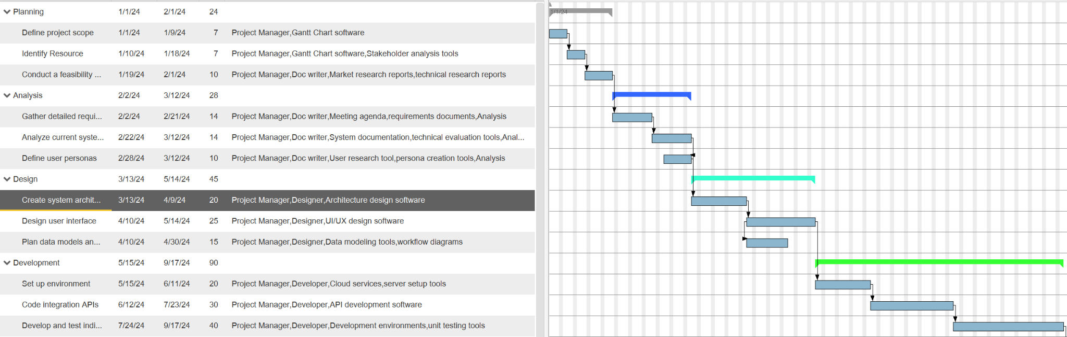
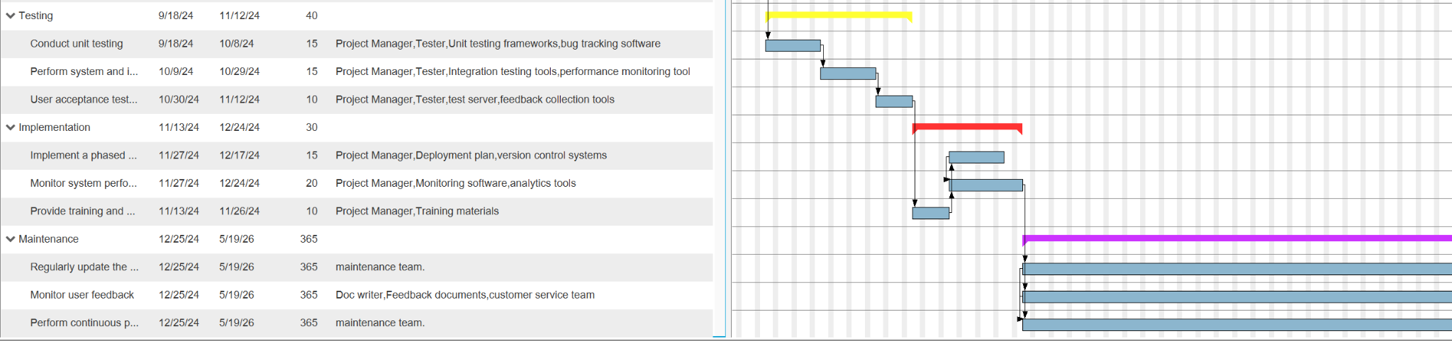
Gantt Chart

Slide 19
Return on Investment
Return on investment on implementation of Dante AI
Estimated 2 hours saved per day
Calculated value of 3.85% of return on investment
Every $1 invested, $1.0385 in return

Slide 20
Thank You For Listening!

